Slide 1
Energy and Power

Slide 2
Energy vs. Power
What’s the difference?

Slide 3
Definitions
Energy is the ability to perform work. Energy is what allows us to do stuff.
Power is the rate at which energy is transformed.

Slide 4
1st Law of Thermodynamics
Energy can never be created or destroyed
So… since we can’t make it, we have to transform existing energy into the kind we need
Can anyone name some common
energy transformations?

Slide 5
Growing Plants
Light Energy →
Chemical Energy

Slide 6
Listening to an iPod
Chemical Energy (from the battery) →
Electrical Energy (in the iPod) →
Sound Energy (from the speakers)

Slide 7
Hydroelectric Dam
Gravitational
Potential Energy →
Motion Energy →
Electrical Energy

Slide 8
Power
So when we say we’re “using” energy or “generating” we’re really just changing it from one form into another
Power is how fast we can (or need to) do that

Slide 9
Some Analogies…
If power is the rate at which we’re moving …
energy is how far we go.

Slide 10
If a Nike factory makes 1,000 shoes in an hour, how many shoes do we have after 8 hours?

Slide 11
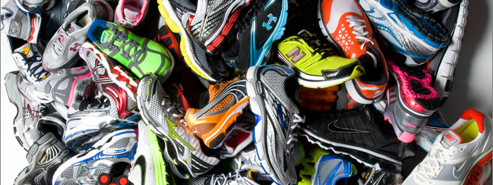
In this example what is analogous to power?
To energy?
Notes:
Power is analogous to the the number of shoes per hour. Energy is the total number of shoes produced over some period of time.

Slide 12
Units!
The International System of Units (SI) unit for power is the Watt
1,000 Watts is called 1 kilowatt
There are many units for measuring energy, but we buy electricity from the utility in kilowatt-hours

Slide 13
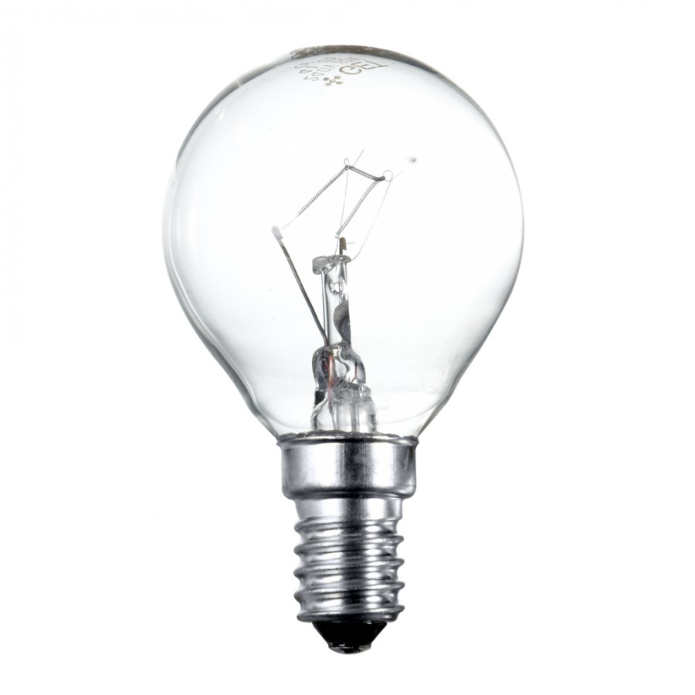
Example: A 100-Watt Light Bulb
A 100-Watt light bulb operates for 20 hours
How many Watt-hours of energy were transformed into light?
How many kilowatt-hours?

Slide 14
Home Energy Consumption Worksheet
Look at the power required to operate each device
Multiply the operating power by the number of hours of operation to find the energy consumed
Multiply the hours of operation per day by 30 to find the energy consumed in a month
Multiply the amount of energy consumed by the cost of energy [PROVIDE COST OF ELECTRICITY HERE]

Slide 15
Homework!
Go home tonight and find three electrical devices
Determine the amount of power needed to operate the device (some devices have the power rating written on them, otherwise you can use a Kill-A-Watt Meter or look it up on the internet)
Estimate the number of hours you use the device per day
Using [COST OF ELECTRICITY] per kilowatt-hour estimate how much the device costs in energy each month

