Slide 1
Photovoltaic and Battery Primer
An Introduction

Slide 2
Putting Photovoltaic Technology to Practical Use
Some key vocab to discuss first:
Voltage (volts) (V)
Current (amperage) (I)
Power (Watts) (P)
P = IV
more info: http://www.youtube.com/watch?v=ZSviOnud7uY

Slide 3
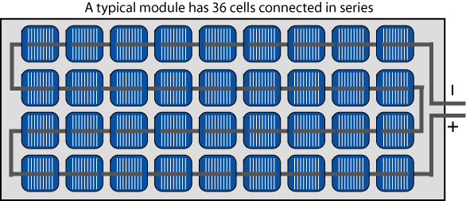
Increasing Voltage
Series Wiring:
Connecting individual cells together ( + to -) into a string.
The voltage of each individual cell accumulates when they are connected in this way

Slide 4
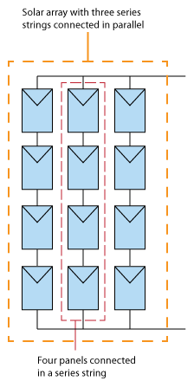
Increasing Current
Parallel Wiring
Connecting PV series together (“+ to +” and “- to-”) into parallel
The current (amperage) of each individual series accumulates when wired in this way.

Slide 5
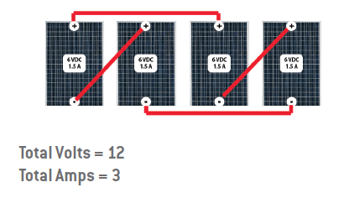
Power (Watts)
The power output is a function of both voltage and amperage and is calculated by multiplying the values together.
If you are not measuring one complete circuit, you will be calculated theoretical max power output.
Notice that 12 volts are achieved by a series of two 6V modules
Notice that 3 amps are achieved by two 1.5A series in parallel
12V x 3A = 36 W Theoretical Max Power

Slide 6
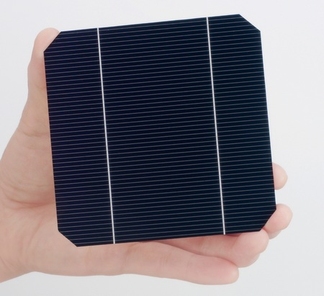
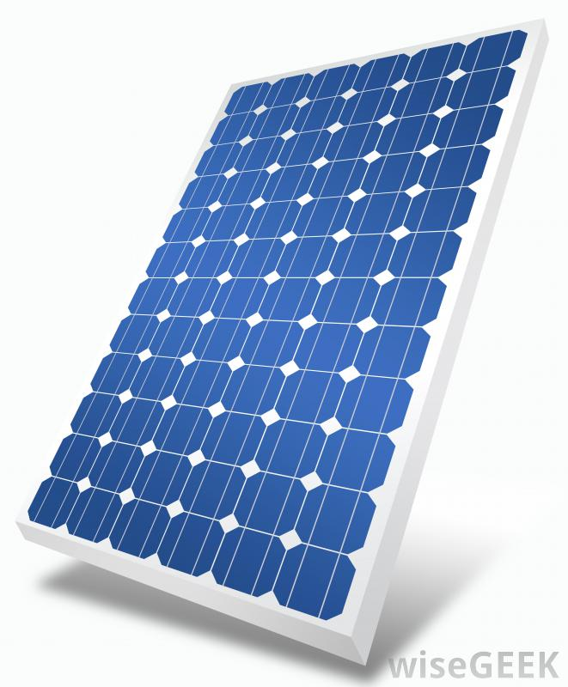
Solar Cells vs. Modules
A solar module is a PV device with multiple PV cells connected electrically (either in series or series and parallel).
PV Cell
PV Module

Slide 7
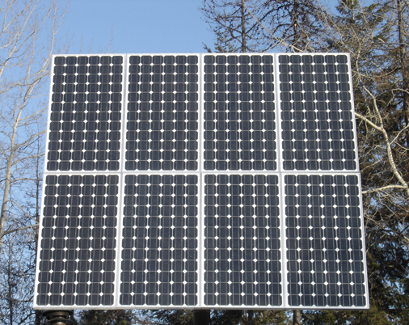
Modules vs. Arrays
A PV array consists of multiple modules connected electrically (either in series or series and parallel)
PV Module
PV Array

Slide 8
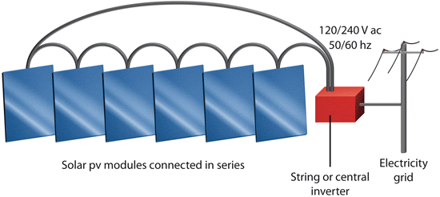
DC to AC Inverters
PV cells, modules, and arrays produce DC (direct current) electricity
In the US, the electrical grid and most household appliances are equipped to handle AC (alternating current) electricity.
(http://www.youtube.com/watch?v=xyQfrzBfnDU for more info.)
To solve this problem, inverters are installed to convert from DC to AC.

Slide 9
Power vs. Energy
In this context, power refers to the instantaneous output of a solar module or array. (W or kW)
Energy is the ability to supply power over time. (Wh or kWh).
Calculated by multiplying the power by the time for which the power is supplied

Slide 10
Power vs. Energy
Power:
Determines whether the source of energy is strong enough to “power” certain devices or homes
Energy:
The ability to sustain certain amounts of power over time

Slide 11
Power vs. Energy in Solar Arrays
A typical solar panel is rated at 200W
Is this power or energy?
In W WA, we average 5 hours of peak sunlight each day (more in summer, less in winter)
How could you determine the average daily energy value provided by a single panel?
Solar panels can easily be scaled-up to provide both the power and energy needed to replace fossil fuels
Why do they still pose a problem for us?

