Slide 1
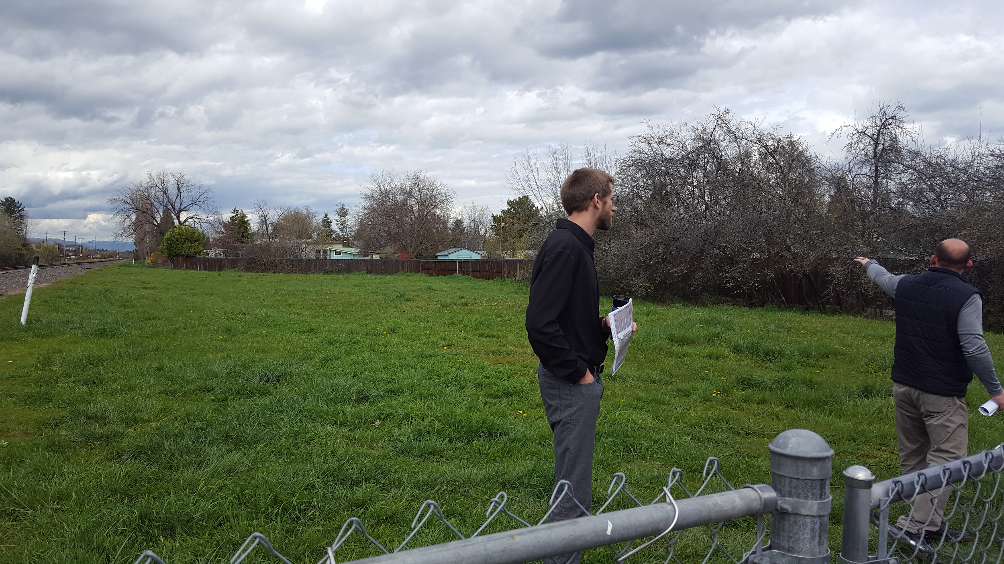
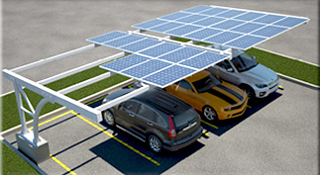
Solar Project Options
City Hall and the Depot
Places solar panels on carports in existing parking lot
2) Solar panels on racks in the open field
Notes:
Julie Johnson, Alyssa Lake, Carter Morrison

Slide 2
Benefits
Carports:
Shade for cars
Covering the parking creates a surplus of energy that can be used to power other city buildings
Leaves field open for Harvest Festival parking
Field:
Room for growth
Faster return on investment
Finding a better use for the field, instead of being used once a year

Slide 3
Drawbacks
Carports:
Car might hit a structure - expense for fixing / replacing
Limits parking for oversized vehicles
Field:
Takes harvest festival parking
We need to add soft surface area for stormwater
Need to add access drive for maintenance

Slide 4
Cost Comparison
Options | Installation Cost | System Size | Commercial Rebate | Approx. Annual Value | Return on Investment
Carport | $295,665 | 72 kw | $25,000 | $12,000 | 23
Fixed rack | $216,000 | 72 kw | $25,000 | 18 | 18
Single-Axis Tracking Racks | $304,000 | 64 kw |  | $10,650 | 28.5
Dual-Axis Tracking Racks | $318,000 | 53 kw |  | $10,550 | 30

Slide 5
Recommendation: Solar on Carports
Shade for cars
Covering the parking creates a surplus of energy that can be used to power other city buildings
Leaves field open for Harvest Festival parking
Installation cost (after rebate): $270,665
Annual value: $12,000
23 year return on investment

