Slide 1
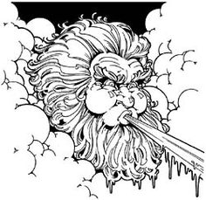
Wind
The movement of air

Slide 2
Questions to contemplate
What is wind made of?
What causes wind?
Why does a hot air balloon rise?
Why do your ears pop?

Slide 3
Demonstration: Egg in a Bottle
Draw a diagram of the demonstration.
After watching the demonstration answer the following questions:
2) What did you notice? Record your observations on your paper.
3) What do you think caused what you saw? Describe your ideas in detail on your paper.

Slide 4
Demonstration: Soda Can
Draw a diagram of the demonstration.
After watching the demonstration answer the following questions:
2) What did you notice? Record your observations on your paper.
3) What do you think caused what you saw? Describe your ideas in detail on your paper.

Slide 5
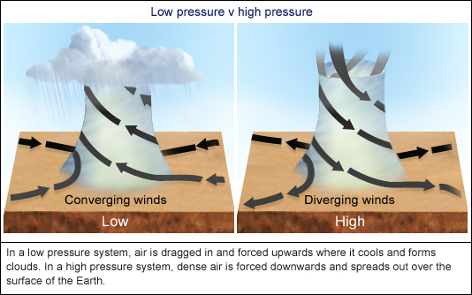
What causes wind?
What is Wind?
Wind always blows from high pressure to low pressure
Winds blow outwards clockwise from high pressure systems

Slide 6
Sources
NEED: National Energy Education Development Project, Introduction to Wind
https://windexchange.energy.gov/maps-data/319
https://www.weather.gov/source/zhu/ZHU_Training_Page/winds/Wx_Terms/Flight_Environment.htm

