Slide 1
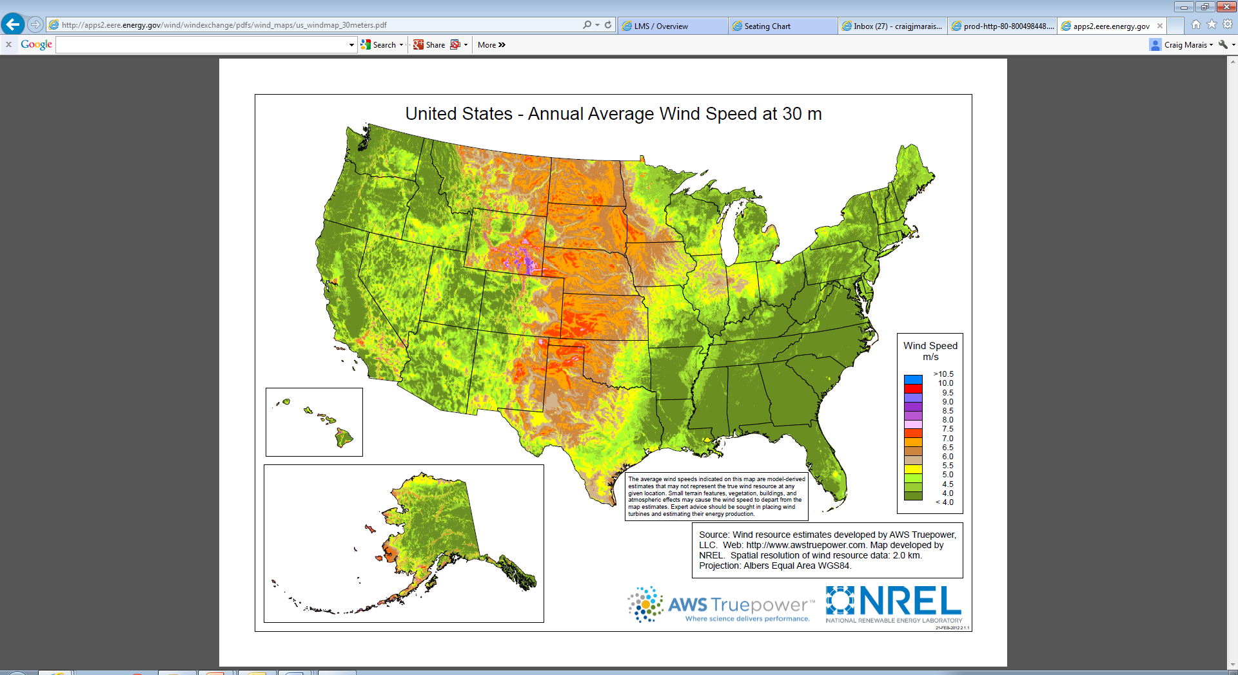
http://apps2.eere.energy.gov/wind/windexchange/windmaps/residential_scale.asp
Note: The link above allows you to click on any state above for a more detailed regional wind map

Slide 2
