Slide 1
Is all Fire the Same?
On your white board, write down your initial thoughts on this question.

Slide 2
Which energy resources should I stash to be prepared for a natural disaster?
How can we apply our understanding of atoms and molecules to make wise choices?

Slide 3
Recall our first lesson…
We talked about the needs that people had after Hurricane Maria took out the power in Puerto Rico. High on the list were warmth, light, to cook, and to boil water for sterilization.
We brainstormed items that we might have at home to support these needs.

Slide 4
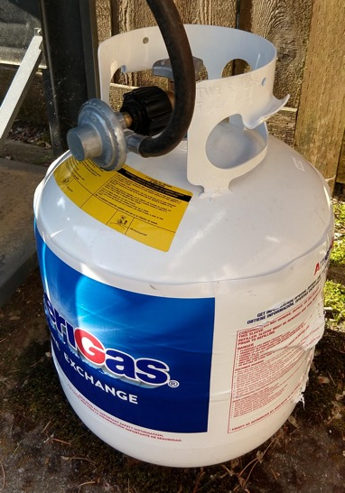
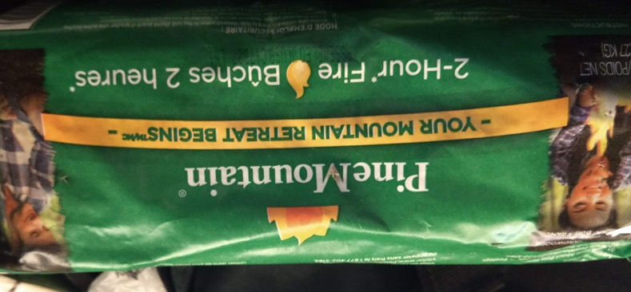
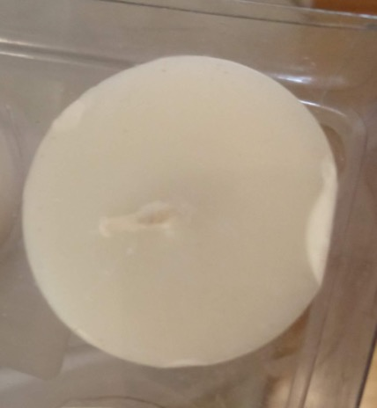
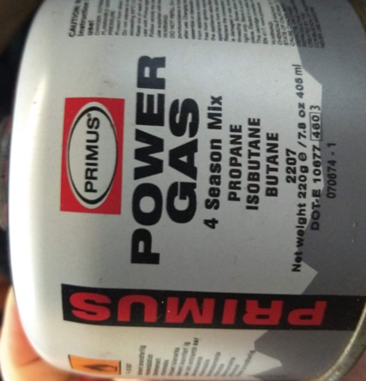
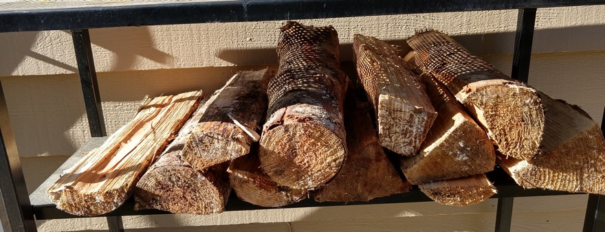
In my home, I found…

Slide 5
ALL FUELS use chemical reactions to release energy
A chemical reaction is when atoms in molecules rearrange to form new compounds.
Reactants → Products

Slide 6
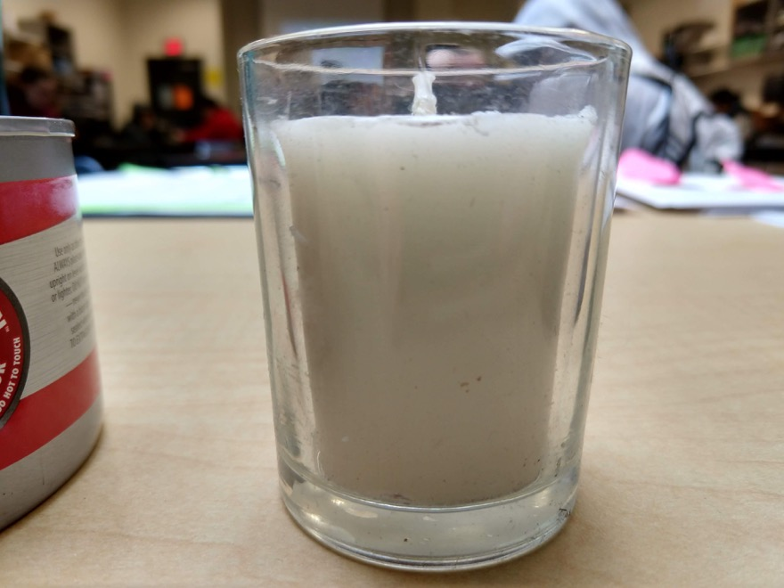
What will happen…
…if I light this candle,
then put a jar over the candle holder?

Slide 7
What will happen…
Eventually, the candle holder will be empty. Where does the wax go?

Slide 8
Combustion Reactions
BURN A FUEL (this one is methane)
IN THE PRESENCE OF OXYGEN
Carbon
Dioxide
Water
CH₄ + O₂ → CO₂ + H₂O

Slide 9
Combustion Reactions
LAW OF CONSERVATION OF MASS: No atoms are created or destroyed, so the two sides of the chemical EQUATION have to BALANCE.
Atoms in reactants: Atoms in products:
C: 1 H: 4 O: 2 C: 1 H: 2 O: 3
NOT BALANCED! NOT CORRECT.
CH₄ + O₂ → CO₂ + H₂O

Slide 10
Combustion Reactions
LAW OF CONSERVATION OF MASS: No atoms are created or destroyed, so the two sides of the chemical EQUATION have to BALANCE.
Atoms in reactants: Atoms in products:
C: 1 H: 4 O: 4 C: 1 H: 4 O: 4
BALANCED! CORRECT.
CH₄ + 2 O₂ → CO₂ + 2 H₂O

Slide 11
Back to those supplies I found around my home…

Slide 12
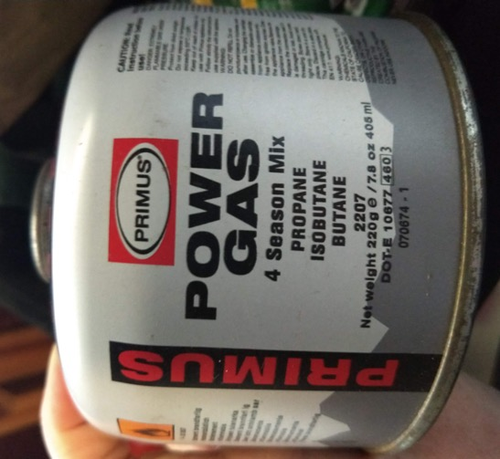
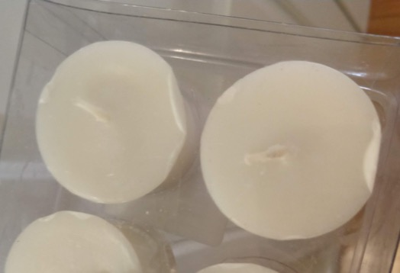
If I needed to leave my home, portability matters, so I want to know which of these three fuels should I stock up on?

Slide 13
Each Resource uses a different molecule as fuel.
Candle: Wax, which is a hydrocarbon
Camping fuel: Propane, Butane, Isobutane
Sterno: ethanol, which is a molecule made of carbon, hydrogen, and oxygen.
(PSA: Even though ethanol is also in alcoholic beverages, this is denatured alcohol, which means if you consume it, it will poison you. The same is true for rubbing alcohol, which is isopropanol.)

Slide 14
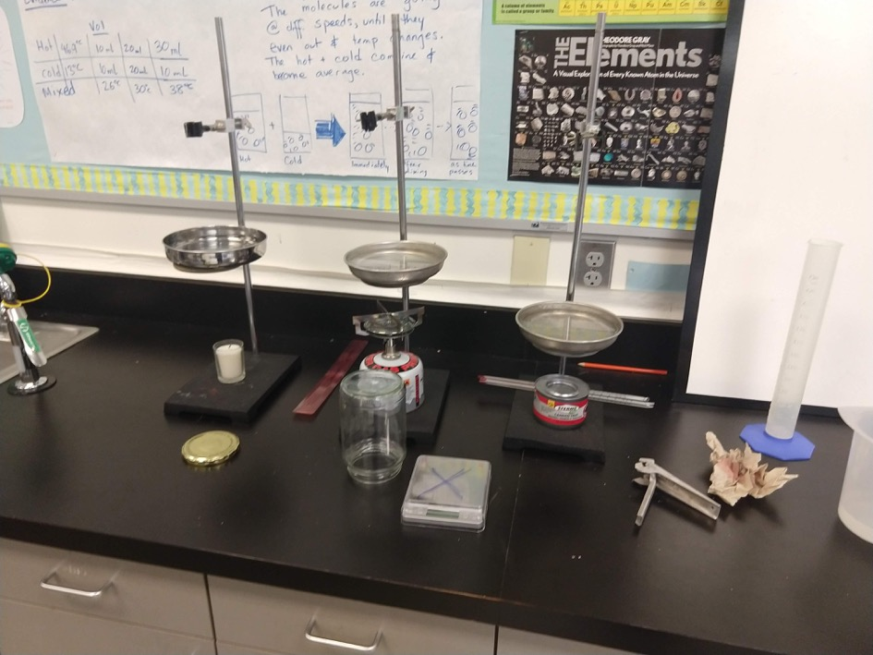
Our inquiry question: For its mass, which fuel will produce the most energy?
Supplies:
Fuels
Ring stands
Thermometers
Timer
Graduated Cylinder
Balance
Water
Metal Dish / Pan

Slide 15
Variables
For its mass, which fuel will produce the most energy?
Independent variable: ?
Dependent variables: ? + ?
(we will measure two things, then do a calculation to give us a number to compare the fuels)

Slide 16
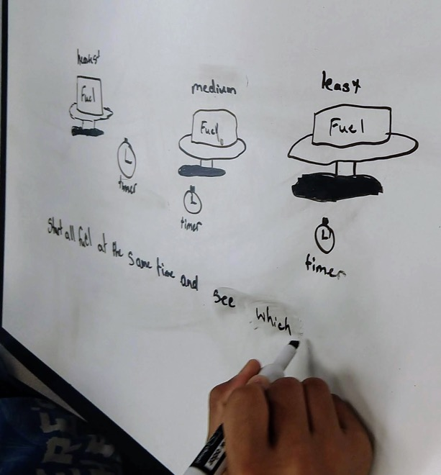
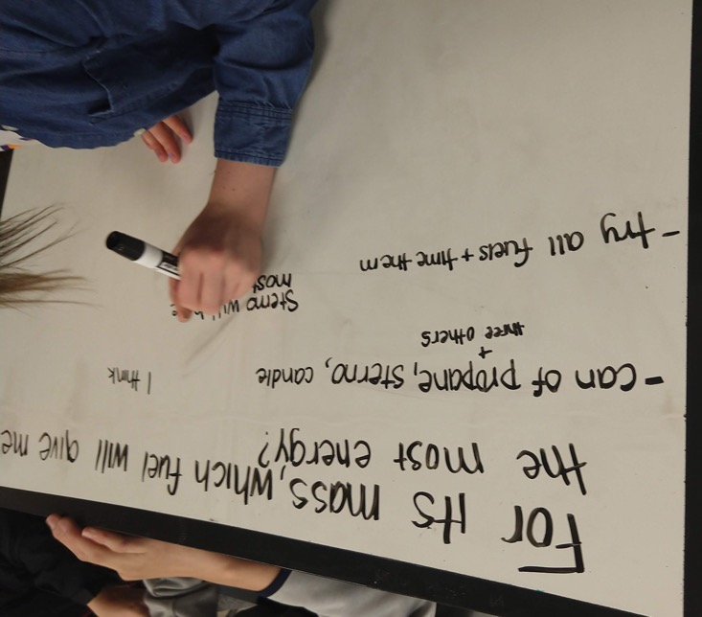
Work as a table group to write a procedure

Slide 17
Agree upon a procedure to conduct as a class
What do we need to control?
How will we know how much energy the fuel generates?
How will we know how much of each fuel we use?

Slide 18
Add a data table to your whiteboard
What do you need to measure?
How can you organize it?
What units will you use?

Slide 19
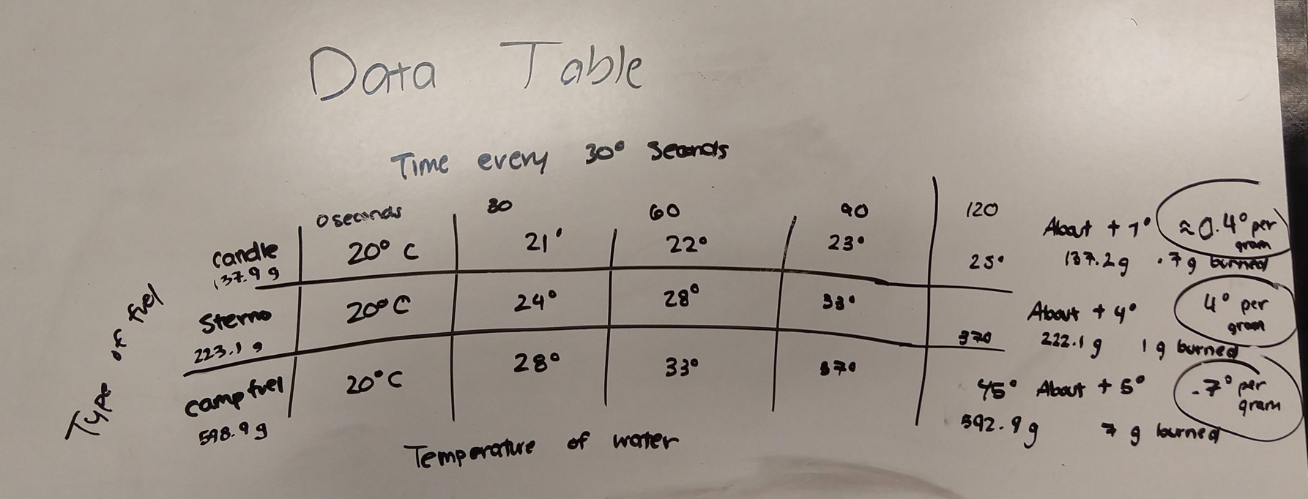
Degrees water increased per Gram of fuel used

Slide 20
Write an evidence-based argument:
For each need that we listed: light, warmth, cooking, boiling water, which fuel should we use? Be sure to include data to support your choice.
Ex: For light, I would pack __________. Our data shows that _________________________. This is the best choice because _____________.
*This is practice for your assessment, which will be making a supply list with justification.

