Slide 1
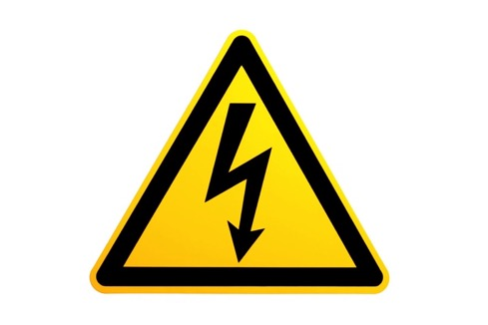
Making Electricity
What things make electricity?
A look at the way electricity is made.

Slide 2
Do you know what this is?
It is one way of making electricity…

Slide 3
This is a coal fired power plant.
Coal is mined from the earth and then is burned to make electricity. This type of electricity power plant is more common in the eastern United States.

Slide 4
Do you know what this is?
It is another way that electricity can be made…

Slide 5
This is a gas powered generator.
The generator makes electricity by burning gas. Many people power cabins or small appliance with these. They can be very handy if the power does go out.

Slide 6
Do you know what this is?
It is another way that electricity can be made…

Slide 7
This is a geothermal power plant.
This power plant uses the heat of the earth to make electricity. The heat makes water turn into steam that spin motors to make electricity.

Slide 8
Do you know what this is?
It is another way that electricity can be made…

Slide 9
This is a hydroelectric power plant or a dam.
A dam is built across a river creating a lake behind the dam. When the water is released through the dam, propellers turn and create electricity.

Slide 10
Do you know what this is?
It is another way that electricity can be made…

Slide 11
This is a solar power plant.
These solar panels are aimed at the sun and follow it as it passes through the sky. The suns light is collected in the panels and turned into electricity.

Slide 12
Do you know what this is?
It is another way that electricity can be made…

Slide 13
This is a wind farm or wind power plant.
The wind turns the large blades of each wind turbine creating electricity.

Slide 14
Do you know what this is?
It is another way that electricity can be made…

Slide 15
This is a nuclear power plant.
A nuclear power plant is where nuclear reactions create electricity.

Slide 16
Do you know what this is?
It is another way that electricity can be made…

Slide 17
This is a natural gas power plant.
Natural gas is collect from underneath the earth and burned to make electricity.

Slide 18
Do you know what this is?
It is another way that electricity can be made…

Slide 19
This is a magnet generator.
Metal is spun between two magnets which makes electricity.

Slide 20
Do you know what this is?
It is another way that electricity can be made…

Slide 21
This is a car battery.
Batteries use metals and acid to create chemical reactions where electricity is made. When all the chemicals are used up, the battery is dead. A dead battery does not make electricity any more.

Slide 22
Do you know what this is?
It is another way that electricity can be made…

Slide 23
This is a tidal power plant.
This is a pretty new way to make electricity. The movement of the oceans tides spins propellers which can make electricity.

Slide 24
Making Electricity
There are many different ways to make electricity. These are just some of the ways. In the next several lessons, we will be doing inquiries about one way to make electricity. Can you guess which one? Here is a hint. It is the only one that does not make electricity at night.

